Slide 1
Nakuja Internship 2026
Solid Propulsion Team
Weekly report #3
Presented by: Ben Wetu
July 3, 2026

Slide 2
Tasks completed this week
Cooked one propellant grain
Prepared 3 pyrogenic ignitors
Validated the error we got from open motor for the one grain test
Motor assembly
Designed a new ignitor circuit casing

Slide 3
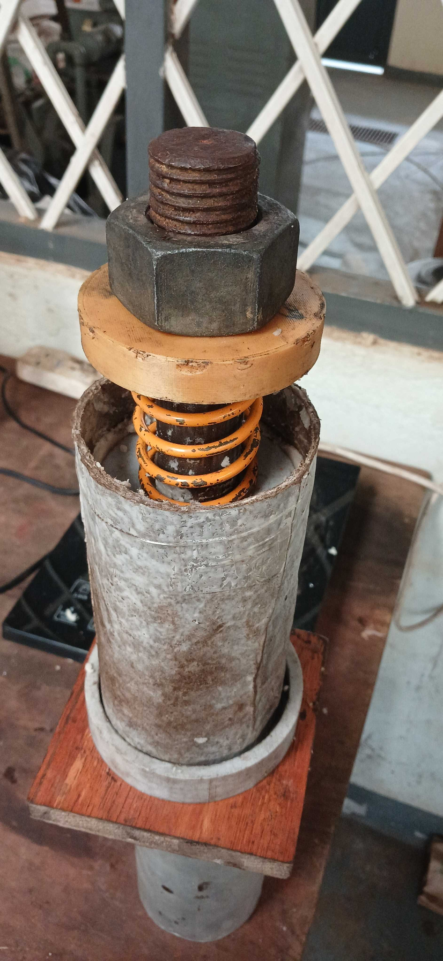
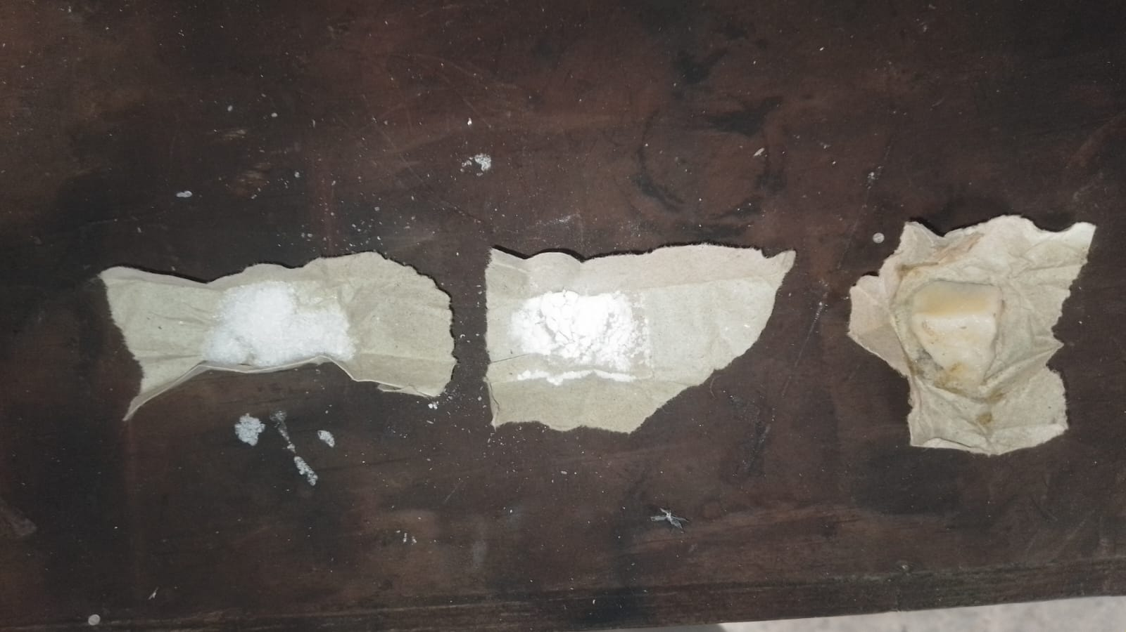
Cooked one grain
Purpose: This Potassium Nitrate & Sorbitol (KNSB) propellant grain will be used as the control grain for the upcoming grain analysis and testing campaign. This propellant grain will be used for microscopic analysis to determine the number of voids or air bubbles formed during the curing process.
The grains were compressed with a force of 236.88 N with a compression length of 2.8 cm. The spring details are here.
Sections for microscopic analysis:

Slide 4
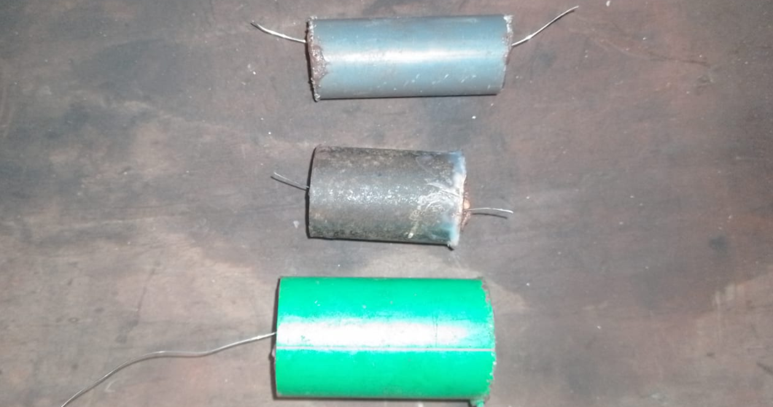
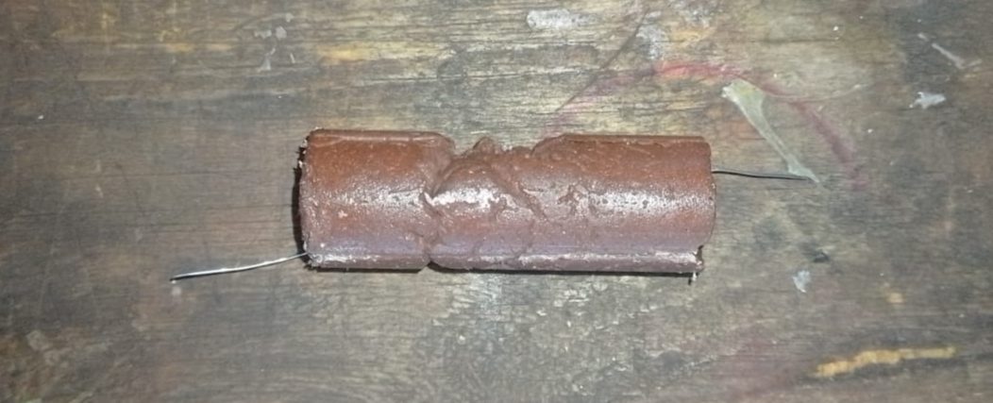
2. Preparation of pyrogenic ignitor
We embarked on designing a new pyrogenic ignitor by adding Black Powder (Potassium Nitrate, Sulphur, Charcoal) to the previous KNSB + FeO3 ignitor.
This was done to improve the ignition properties of the pyrogenic ignitor thus leading to a faster and more reliable Solid Rocket Motor ignition with the right chamber pressure.
Tests on the new ignitor design shall be done next week.

Slide 5
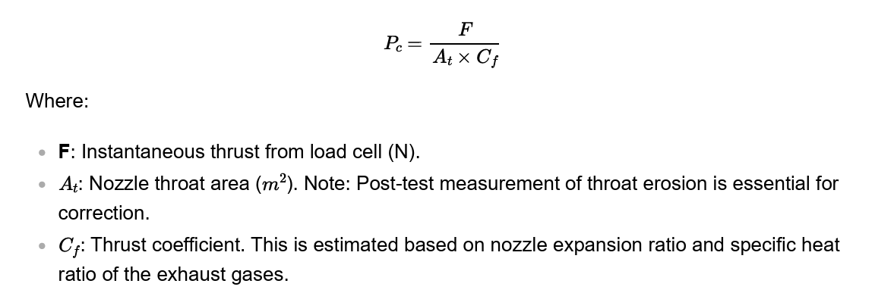
3. Error validation from Open Motor
Upon simulating, the motor performance for the one grain test, we encountered an open motor error; low exit pressure nozzle flow may separate but upon research from Richard Nakka and consulting with early N4 members, we concluded the following (full documentation available here) also uploaded to github:
No need to change the grain diameter and nozzle size in order to test hardware to be used in the 5 grain static test.
It is possible to obtain the pressure exponent without a pressure sensor using the following relation:

Slide 6
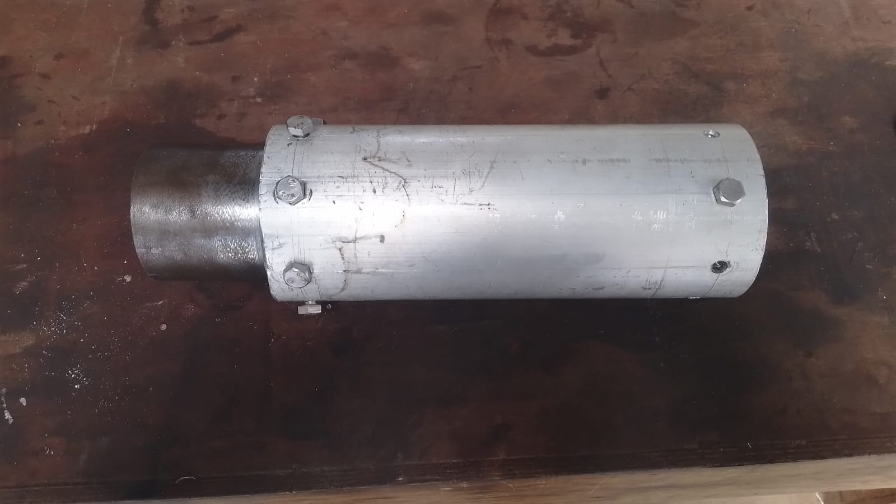
4. Motor Assembly for one grain test
The machining sub-team began and completed assembling the dry solid rocket motor in preparation for a one grain test.

Slide 7
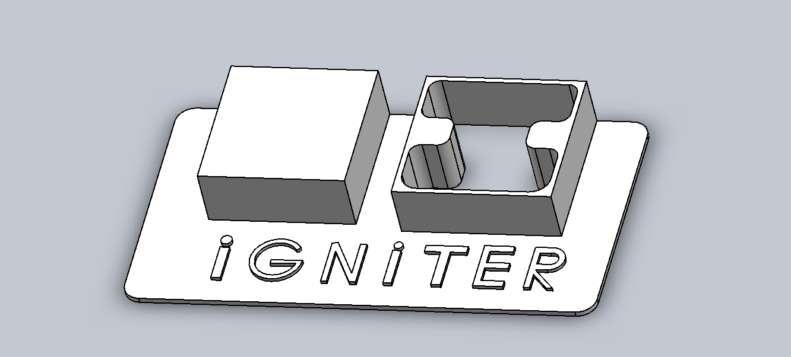
5. Designed new ignitor circuit casing
The ignitor circuit i.e. the one used to ignite the nichrome wire to fire the solid rocket motor, needed a new casing design and the following was the proposed design which is ready for 3D printing as soon as the filament is purchased

Slide 8
Next week's tasks
Pyrogenic ignitor testing
Cooking of grains for one grain static test
Old grains disposal
Liner thickness testing (Burn test)
Purchasing of items i.e. Stainless steel casing, crafting paper
Motor assembly for one grain test
3D print ignition circuit casing

Slide 9
Challenges experienced
Delayed procurement of items led to stalling of some tasks.
Supervisors’ note:
Visit Solid Propulsion github projects @ https://github.com/orgs/nakujaproject/projects/26 to review the tasks done.

Slide 10
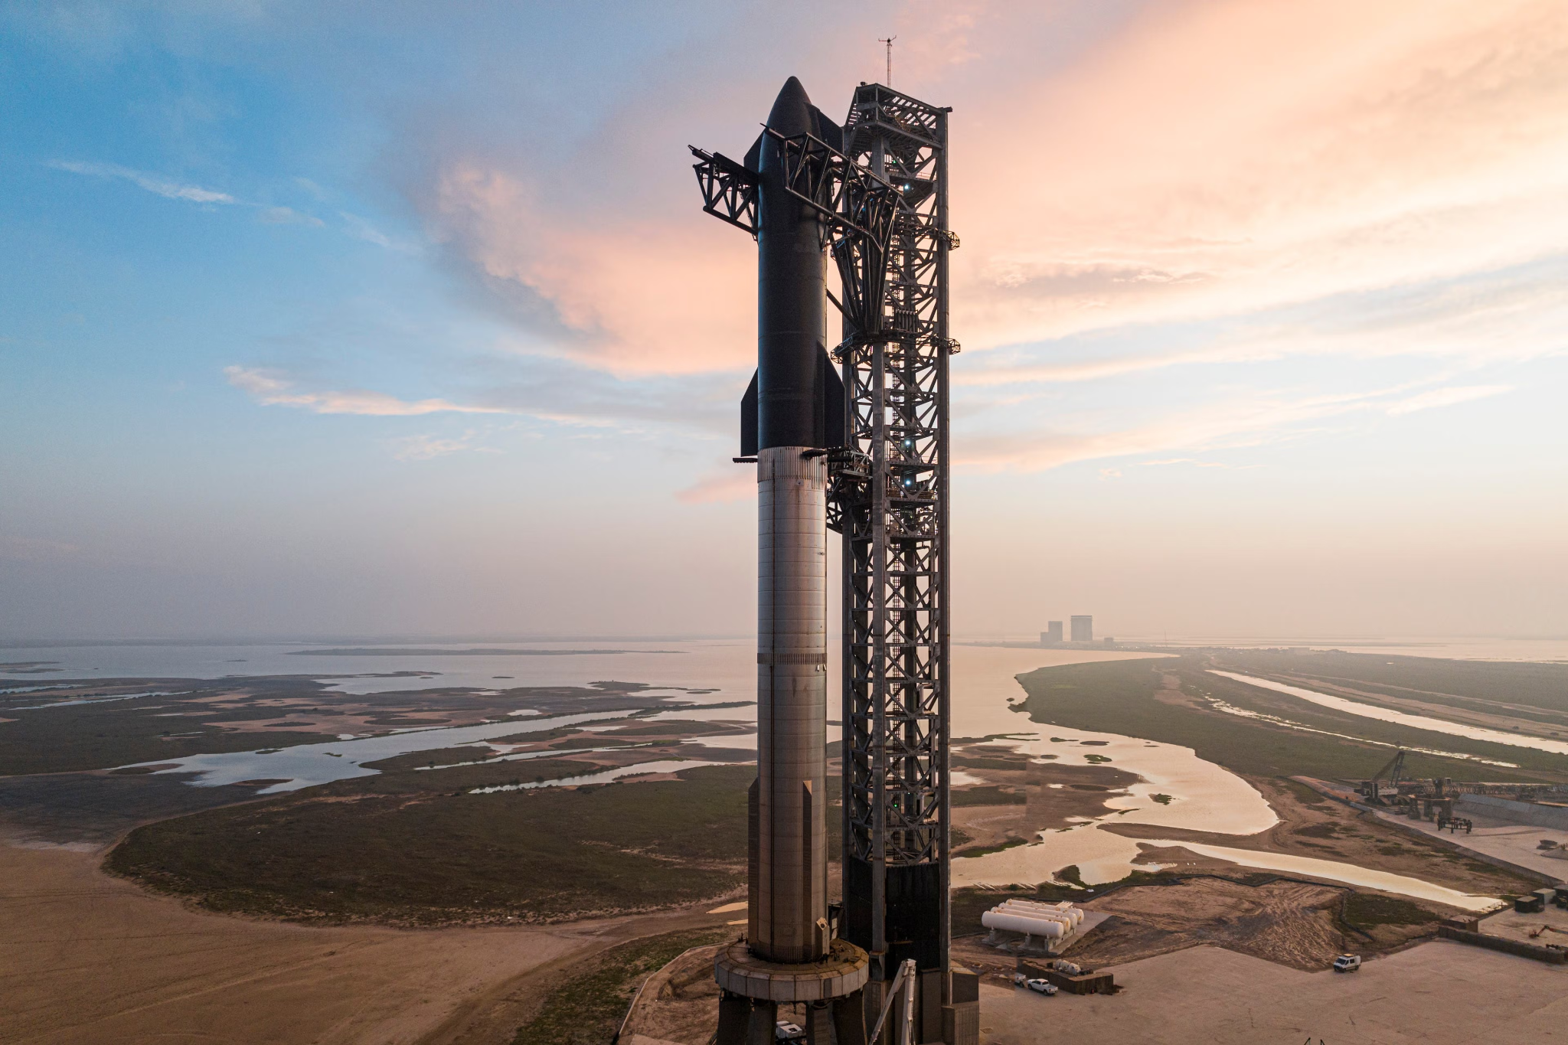
Thank you for your Attention!

